Slide 1
SS ZG 526: Distributed Computing
Distributed Mutual Exclusion (DME)
Chittaranjan Hota
Professor, Dept. of Computer Sc. & Information Systems
BITS, Pilani Hyderabad Campus, Hyderabad
hota@hyderabad.bits-pilani.ac.in

Slide 2
Lamport’s Distributed Mutual Exclusion
Requesting the critical section.
1. When a site Si wants to enter the CS, it sends a REQUEST(T=tsi, i) message to all the sites in its request set Ri and places the request on request_queuei.
2. When a site Sj receives the REQUEST(tsi , i) message from site Si, it returns a timestamped REPLY message to Si and places site Si’s request on request_queuej.
Executing the critical section.
Site Si enters the CS when the two following conditions hold:
1. Si has received a message with timestamp larger than (tsi, i) from all other sites.
2. Si’s request is at the top of request_queuei.
Birla Institute of Technology and Science, Pilani (Deemed University)

Slide 3
Continued…
Releasing the critical section.
1. Site Si, upon exiting the CS, removes its’ request from the top of its’ request queue and sends a timestamped RELEASE message to all the sites in its request set.
2. When a site Sj receives a RELEASE message from site Si, it removes Si’s request from its request queue.
3. When a site removes a request from its request queue, its own request may become the top of the queue, enabling it to enter the CS. The algorithm executes CS requests in the increasing order of timestamps.
Birla Institute of Technology and Science, Pilani (Deemed University)

Slide 4
Example
Birla Institute of Technology and Science, Pilani (Deemed University)

Slide 5
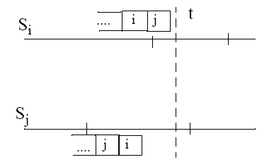
Correctness
Suppose that both Si and Sj were in CS at the same time (t).
Then we have:
Birla Institute of Technology and Science, Pilani (Deemed University)

Slide 6
Next Session
Ricart-Agrawala, and Maekawa’s DME
Birla Institute of Technology and Science, Pilani (Deemed University)

